Slide 1

TankopaniJam
(aka Nemours Game Jam)
Notes:
72 Hours, 1 Game: A First-Timer’s Guide to Game Jams | by Andrew Lukes | Medium
What is a game jam? | Global Game Jam
Master Game Jams With This Definitive Guide | GameMaker
Game Jams 101: What Is A Game Jam?

Slide 2

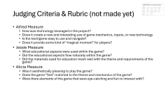


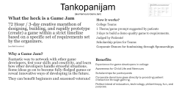
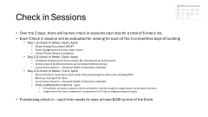
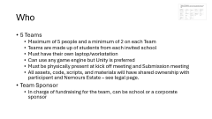

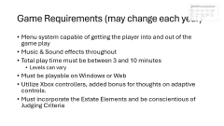
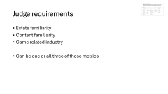




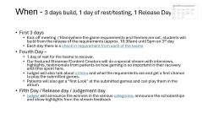

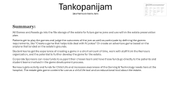
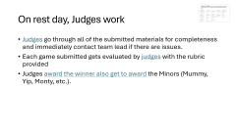
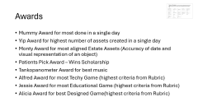

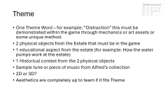

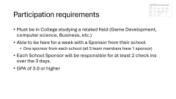


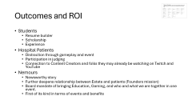
Table of Contents – click on each to go to that slide, image at top will bring you back here. Also, some key words are hyperlinked to their description slide
What is a Game Jam
Summary
Who
Participation Requirements
Timeline
Criteria for Judging
Judging Day
Game Requirements
Theme
Check ins
Awards
Judging Requirements
ROI

Slide 3

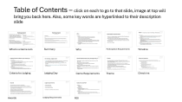
Tankopanijam
(aka Nemours Game Jam)
What the heck is a Game Jam
72 Hour / 3-day creative marathon of designing, building, and rapidly prototype (create) a game within a strict timeline based on a specific set of requirements set by the organizers.
(see link in notes)
How it works?
College Teams
1 Theme/game prompt suggested by patients
3 days to build a demo quality game to requirements.
Judged by Patients!
Scholarship prizes for Teams
Corporate Donors for fundraising through Sponsorships
Why a Game Jam?
Fantastic way to network with other game developers, test your skills and creativity, and learn how other developers handle stressful situations. Some ideas go on to become fully-fledged games or reveal innovative ways of developing in the future.
They can benefit beginners and seasoned veterans!
Benefits
Experience for game developers in college
Awareness for Child Life and Nemours
Scholarships for participants
Corporate donations goes directly to providing patient interaction through gaming.
Perfect blend of education, technology, philanthropy, fun, and purpose.
Notes:
72 Hours, 1 Game: A First-Timer’s Guide to Game Jams | by Andrew Lukes | Medium
What is a game jam? | Global Game Jam
Master Game Jams With This Definitive Guide | GameMaker
Game Jams 101: What Is A Game Jam?

Slide 4
Tankopanijam
(aka Nemours Game Jam)
Summary:
All Games and Assets go into the file storage of the estate for future game jams and use within the estate preservation plan.
Patients get to play the games and judge the outcomes of the jam as well as participate by defining the games requirements, like “Create a game that helps kids deal with IV pokes” Or create an adventure game based on the airplane that landed on the estate’s grounds.
Student teams get the experience of creating a game in a short amount of time, work with staff from the Nemours organization, and the potential to further develop the game for the estate.
Corporate Sponsors can raise funds to support their chosen team and have those funds go directly to the patients and student teams involved in the game development process.
Nemours gets activity and funds for Child Life and increases awareness of the Gaming & Technology needs here at the hospital. The estate gets game content for use as a child life tool and an educational tool about the estate.
Notes:
72 Hours, 1 Game: A First-Timer’s Guide to Game Jams | by Andrew Lukes | Medium
What is a game jam? | Global Game Jam
Master Game Jams With This Definitive Guide | GameMaker
Game Jams 101: What Is A Game Jam?

Slide 5
Who
5 Teams
  Maximum of 5 people and a minimum of 2 on each Team
  Teams are made up of students from each invited school
  Must have their own laptop/workstation
  Can use any game engine but Unity is preferred
  Must be physically present at kick off meeting and Submission meeting
  All assets, code, scripts, and materials will have shared ownership with participant and Nemours Estate – see legal page.
Team Sponsor
  In charge of fundraising for the team, can be school or a corporate sponsor

Slide 6
Participation requirements
Must be in College studying a related field (Game Development, computer science, Business, etc.)
Able to be here for a week with a Sponsor from their school
  One sponsor from each school (all 5 team members have 1 sponsor)
Each School Sponsor will be responsible for at least 2 check ins over the 3 days.
GPA of 3.0 or higher

Slide 7
When - 3 days build, 1 day of rest/testing, 1 Release Day
First 3 days
  Meet and Greet 10am
    Teams meet in the Hospital Atrium for tour of Child Life Clubhouse, CCTV Studio, and School programs.
    Teams also get to meet up with Patient Judges to review their unique needs while gaming and why gaming was important to them while here.
  Kick off meeting 11am
    Game requirements and themes are set, students will build from the release of the requirements (approx. 11:30am) until 5pm on 3rd day
    Team Sponsors are briefed in a separate meeting immediately after.
  Each day there is a check in requirement from each of the teams
Notes:
Code of conduct etc.

Slide 8
When - 3 days build, 1 day of rest/testing, 1 Release Day
Fourth Day –
  1 day of rest for the teams to recover.
  Our featured Streamer/Content Creators will do a special stream with interviews, highlights, testimonials from patients on how gaming is so important in their recovery and time spent here.
  Judges will also talk about criteria and what the requirements are and get a first chance to play the submitted games.
  Patients will also get a “first Look” at the submitted games and can play them in the atrium
Fifth Day / Release day / Judgement day
  Judges will announce the winners in the various categories, announce the scholarships and show highlights from the stream feedback

Slide 9
Judging Criteria & Rubric (not made yet)
Alfred Measure
  How was technology leveraged in the project?
  Does it create a new and interesting use of game mechanics, inputs, or new technology
  Is the tech/game easy to use and navigate?
  Does it provide some kind of “magical moment” for players?
Jessie Measure
  What educational aspects were used within the game?
  Did the educational aspects flow naturally within the game?
  Did the materials used for education mesh well with the theme and requirements of the game?
Alicia Measure
  Was it aesthetically pleasing to play the game?
  Does the game “feel” matched to the theme and mechanics of the game?
  Were there elements of the game that were eye-catching and fun to interact with?

Slide 10
On rest day, Judges work
Judges go through all of the submitted materials for completeness and immediately contact team lead if there are issues.
Each game submitted gets evaluated by judges with the rubric provided
Judges award the winner also get to award the Minors (Mummy, Yip, Monty, etc.).

Slide 11
Patients
We will include a panel of patients (present & former) to give specific insight on how their situations and needs around gaming were met or identified while here.
Any appropriate patient will be allowed to play and participate in Day 3 & 4 for judging and feedback
TAC can also play a part in the Theme development and requirements
Patient video interviews and zoom meetings can be facilitated for questions from Teams

Slide 12
Game Requirements (may change each year)
Menu system capable of getting the player into and out of the game play
Music & Sound effects throughout
Total play time must be between 3 and 10 minutes
  Levels can vary
Must be playable on Windows or Web
Utilize Xbox controllers, added bonus for thoughts on adaptive controls.
Must incorporate the Estate Elements and be conscientious of Judging Criteria

Slide 13
Theme
One Theme Word – for example: “Distraction” this must be demonstrated within the game through mechanics or art assets or some unique method.
2 physical objects from the Estate that must be in the game
1 educational aspect from the estate (for example: How the water pumps work at the estate)
1 Historical context from the 2 physical objects
Sample tune or piece of music from Alfred’s collection
2D or 3D?
Aesthetics are completely up to team if it fits Theme
Notes:
Have a panel of patients talking about their unique needs. Have teams start at hospital get a tour see how we help kids and what they’re going to do has a huge impact on what we do in child life.

Slide 14
Check in Sessions
Over the 3 days, there will be two check in sessions each day for a total of 6 check ins.
Each Check in session will be evaluated for ranking for each of the 3 competitive days of building
  Day 1 (2 check in times, 12pm, 4pm)
    Game Design Document DRAFT
    Team Assignments of roles, team name
    Vision/Theme Board completed
  Day 2 (2 check in times, 12pm, 4pm)
    Complete Assets list of every script, file, document up to this point
    Game project started and back up schedule/method shown
    Lunch time check in – General Health of the team checked
  Day 3 (2 check in times, 11am, 3pm)
    Demo Check in must have some level of functional game with menu working 50%
    Back up of project for 3pm
    Lunch time check in – General Health of the team checked
    FINAL SUBMISSION CHECK IN – 5pm
      A Final Build, all assets, projects, and documentation must be brought to Judges station via provided hard drive
      Judges submit all check in paperwork in preparation for 4th day for judging and play throughs.
Fundraising check in – each team needs to raise at least $200 by end of the Event

Slide 15
Awards
Mummy Award for most done in a single day
Yip Award for highest number of assets created in a single day
Monty Award for most aligned Estate Assets (Accuracy of date and visual representation of an object)
Patients Pick Award – Wins Scholarship
Tankopanometer Award for best music
Alfred Award for most Techy Game (highest criteria from Rubric)
Jessie Award for most Educational Game (highest criteria from Rubric)
Alicia Award for best Designed Game(highest criteria from Rubric)

Slide 16
Judge requirements
Estate familiarity
Content familiarity
Game related industry
Can be one or all three of those metrics

Slide 17
Outcomes and ROI
Students
  Resume builder
  Scholarship
  Experience
Hospital Patients
  Distraction through gameplay and event
  Participation in judging
  Connection to Content Creators and folks they may already be watching on Twitch and YouTube
Nemours
  Newsworthy story
  Further deepens relationship between Estate and patients (Founders mission)
  Board mandate of bringing Education, Gaming, and who and what we are together in one event.
  First of its kind in terms of events and benefits

Slide 18


Alfred – the Original AI
(Copilot AI spelled his name incorrectly)

